Slide 1

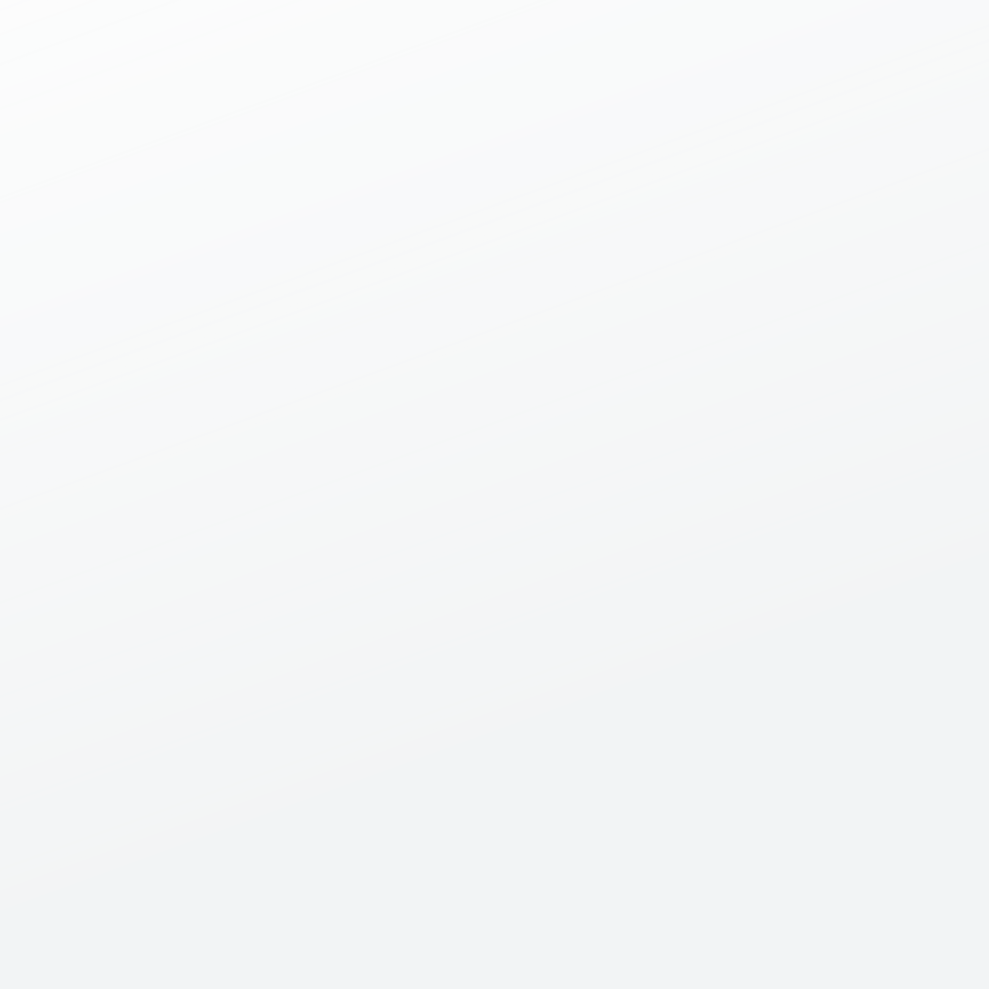

ALGORITHMIC
TRADING

Slide 2

CONTENT
01
OUR TEAM
02
PROBLEM STATEMENT
03
STRATEGY
04
DATASET
05
MODEL STRUCTURE
06
OUTPUT
07
FUTURE SCOPE

Slide 3
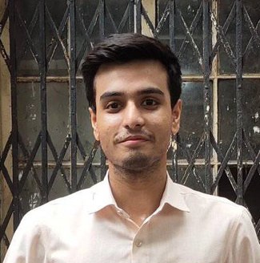




OUR TEAM
FARHAN JAWAID
RAVI SAH
THIBAULT MAGNIN
VEENU CHHABRA
24M0801
24M0854
24V0016
24M2135

Slide 4




PROBLEM STATEMENT
Objective 1
Objective 2
Objective 3
Analyze the best performing companies in the Indian Stock Market
Filter them out and train the model on multiple stocks to predict their prices
Develop a trading strategy based on the predictions from our model for making a fine portfolio for large and mid term goals

Slide 5

STRATEGY
We need to shortlist about 120-150 stocks out of the list of 480+ top stocks at NSE.
We made a model for predicting stock price.
We used the well performing stocks with a combination of stable stocks to make a mutual fund by calculating weightage of stocks.
Split the stocks taken under the SEBI criteria to have a fairly safer portfolio.
Check the performance and compare it with what other top performing mutual funds(flexi cap) performed at that time span.

Slide 6

DATASET
yfinance in Python, fetches the data on Yahoo Finance.
From January 2014 to January 2024.
Closing prices for training.
Financial variables for fundamental analysis.

Slide 7
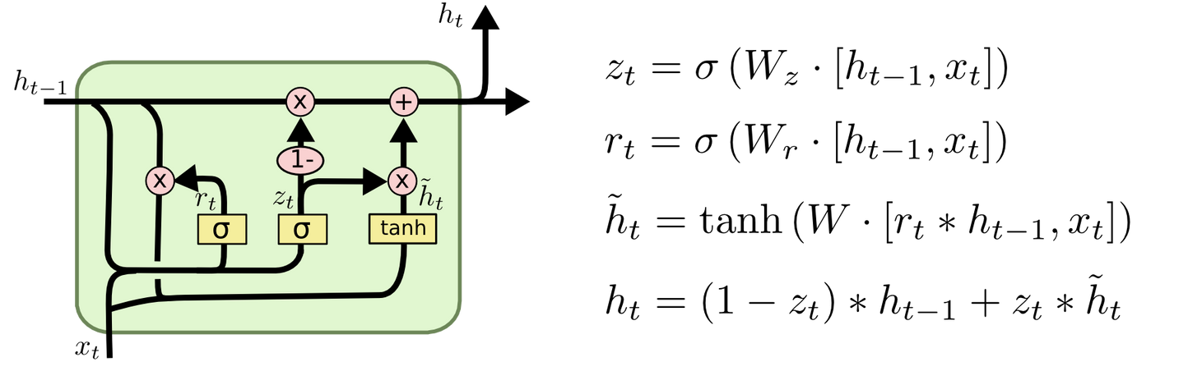

LSTM
Performant for time series forecast
Built-in state memory
Solves vanishing gradient descent problem

Slide 8
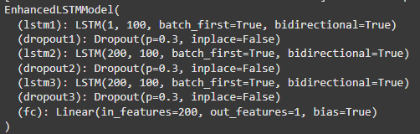
STRUCTURE OF MODEL
3 BIDIRECTIONAL LSTM CELLS
HIDDEN SIZE=100
BATCH_FIRST
3 DROPOUT LAYERS
RATE 0.3

Slide 9
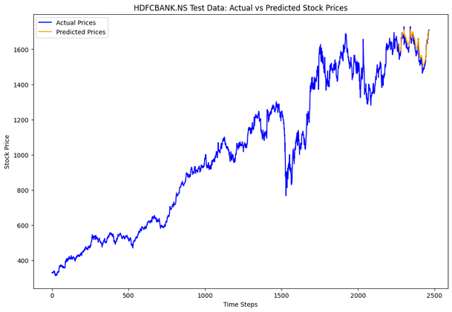
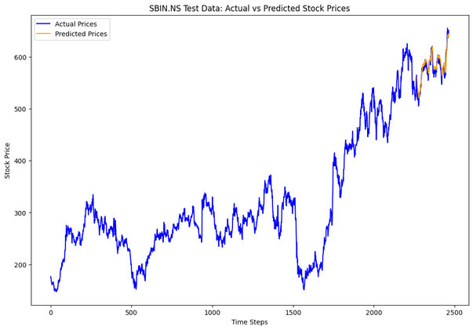
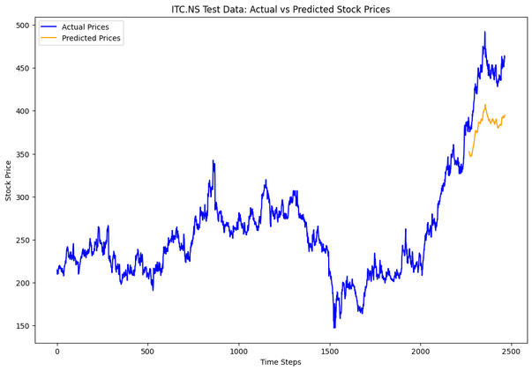
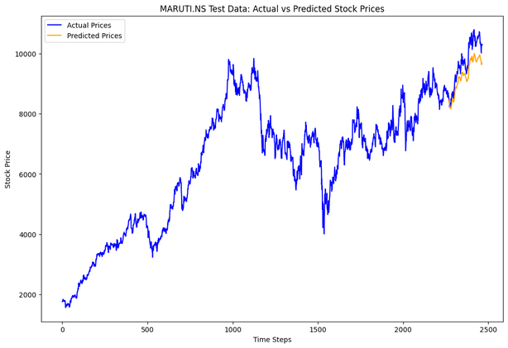
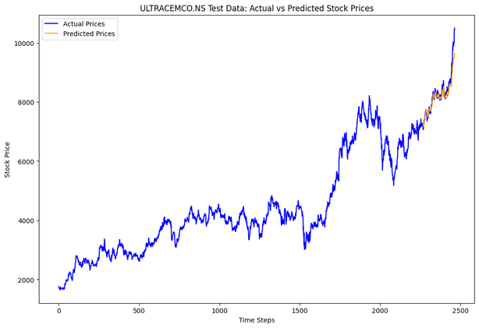
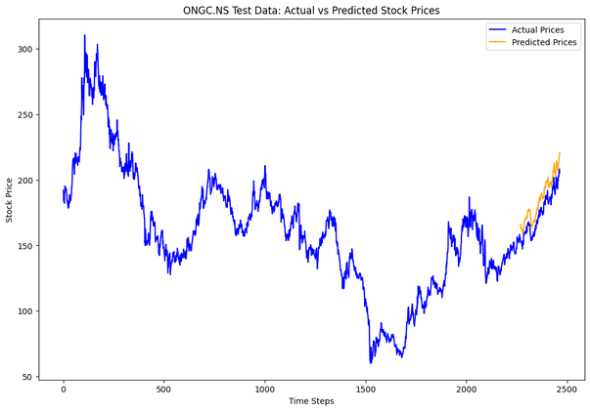
OUTPUT

Slide 10
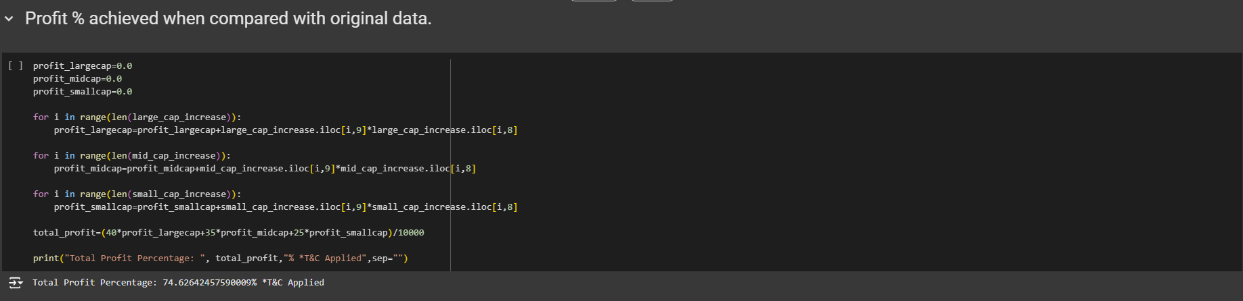
OUTPUT

Slide 11
FUTURE SCOPE
Make the model work on short term goals too for stocks.
Add components like news and market sentiments.
Try with reinforcement learning for decision making.
Improve the weightage formula and make it more dynamic.
Add a user risk capability based optimization for fund composition.

Slide 12
THANK YOU

